Slide 1
Course Orientation

Slide 2
Lecture Orientation (1/6)
Prerequisites
  AI Mathematics
  Probability and Statistics
  Discrete Mathematics
Class Information
  Time : Wed. 5 period (14:00~14:50), Thur. 1-2 period (09:00~10:50)
  Professor: Ji-Hoon Jeong (jh.jeong@chungbuk.ac.kr)
  TA: Jun-Young Oh (jy_oh@chungbuk.ac.kr r)
Textbook : Lecture note
Web : lms.cbnu.ac.kr

Slide 3
Lecture Orientation (2/6)
This course provides a comprehensive introduction to the mathematical foundations of artificial intelligence (AI)
Students will explore fundamental mathematical concepts essential for understanding and implementing AI algorithms
Topics include linear algebra, probability, statistics, calculus, and their applications in machine learning and deep learning

Slide 4
Lecture Orientation (3/6)
Develop a strong mathematical foundation for understanding AI concepts
Apply mathematical techniques to solve AI problems and implement algorithms
Explore the role of mathematics in various AI applications, including machine learning and deep learning
Gain practical experience through hands-on exercises and projects

Slide 5

Lecture Orientation (4/6)
Week | Contents
1-week | 00. Course Orientation
2-week | 01. What is AI
3-week | 02. ML Mathematics with AI
4-week | 03. Basic Mathematics
5-week | 04. Basic Mathematics
6-week | 05. Basic Mathematics
7-week | 06. Differential
8-week | Mid-term Exam
9-week | 07. Differential
10-week | 08. Differential
11-week | 09. Linear Algebra
12-week | 10. Linear Algebra
13-week | 11. Linear Algebra
14-week | 12. Probability & Statistics
15-week | 13. Probability & Statistics
16-week | Final Exam
DALL-E
@OpenAI

Slide 6
Lecture Orientation (5/6)
이론 수업
  인공지능수학 개론에 관해 단원별로 진행
  주요 공지를 위해, 반드시 수업 시간 전에 이론이든 실습이든 항상 공지사항을 확인
평가
  출석 10%
    동영상 수업만 있는 경우, 해당 수업일에 모든 동영상으로 시청 완료하면 출석으로 인정,
    수업 날 시청완료해야 함
  과제 및 퀴즈 20%
    인공지능에 사용되는 기본적인 알고리즘 구현
  시험 70%
    중간고사: 35%
    기말고사 : 35%

Slide 7
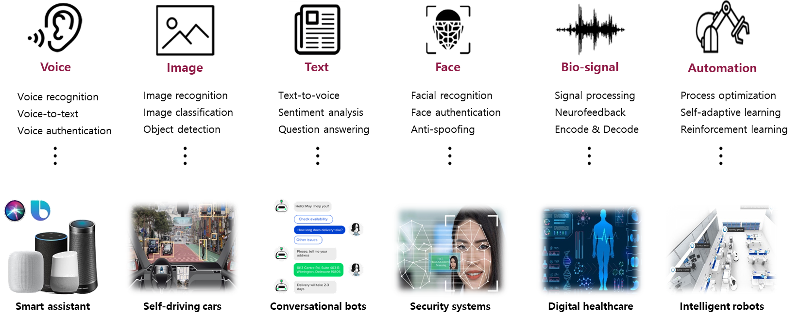
Lecture Orientation (6/6)

Slide 8

Q&A
DALL-E @OpenAI

